Slide 1




PANIC ON TWO FRONTS
Michael Maimoni
Joana Sean

Slide 2
CONTEXT
Utilize ETL methods to enable an analysis of epidemic death rates against changes in the stock market closing prices.
Categories of Interest: Deaths, Stock Market Close
Variable Types: Rates of Change
Periodicity: Daily
Time Frames: 3-12 months

Slide 3
Data Discovery
SARS
EBOLA
March 2003 – July 2003
August 2014 – March 2016
H1N1 FLU
COVID-19
May 2009 – July 2009
January 2020– March 2020(?)

Slide 4
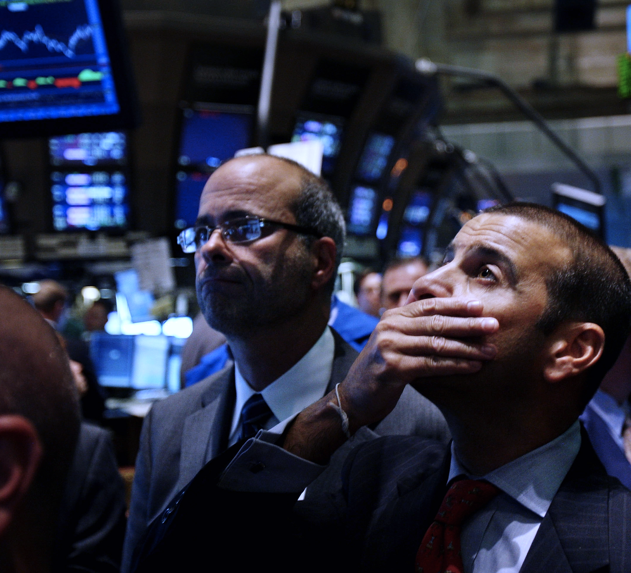
FINAL SOURCES
DOW JONES INDUSTRIAL AVERAGE (Yahoo Finance)
Center for Disease Control
Thanks to: Dev A. Kumar

Slide 5
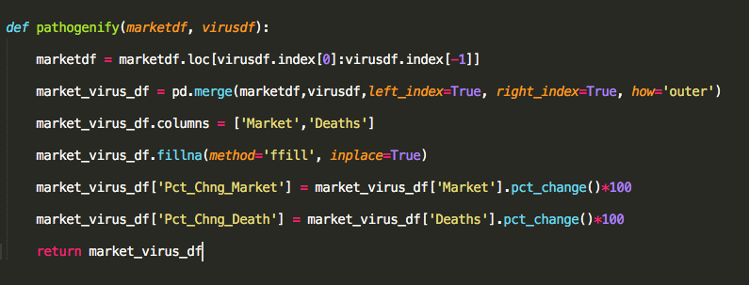
# Restrict Data
# Outer Join
# Rename Columns
# Forward Fill
# Calculation of Percent Changes
For all transformation details, please refer to the Jupyter Notebook

Slide 6
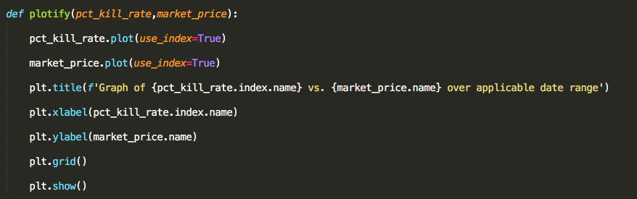
# LINE PLOT
# X-Y LABEL
# GRID
For all visualization details, please refer to the Jupyter Notebook

Slide 7
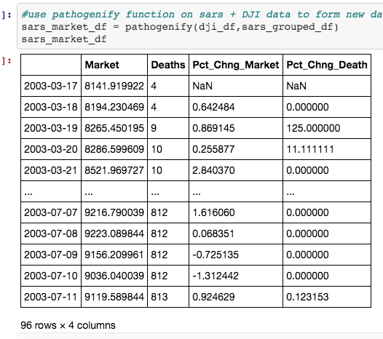
Proof Of Concept
Dataset: SARS
March 2003 to July 2003

Slide 8
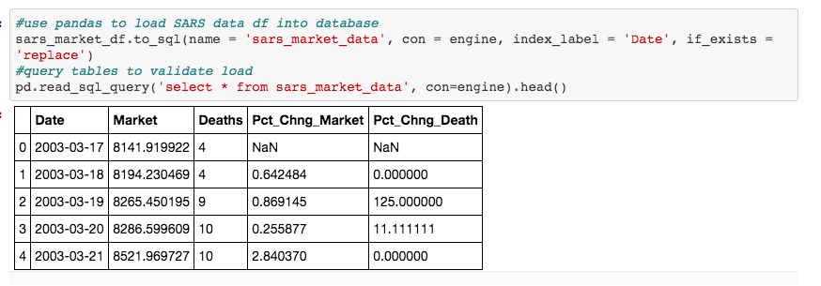
SARS LOAD: TO AWS RDS DB

Slide 9
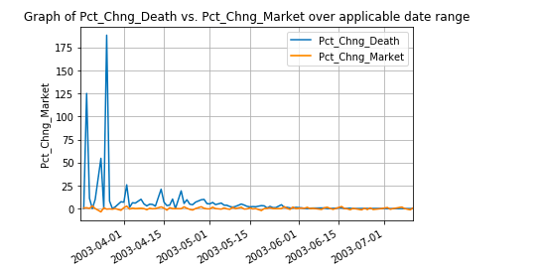
SARS: READ SQL & PLOTIFY( )
sars_extract = pd.read_sql_query('select * from sars_market_data', con=engine)
sars_extract = sars_extract.set_index('Date’)
plotify(sars_extract['Pct_Chng_Death'],sars_extract['Pct_Chng_Market'])
**DISCLAIMER: This is not registered investment advice.

Slide 10
Future Research
If we had more time, the following exploratory transformation techniques would be executed (in no specific order):
Lambda Functions – The attempt to apply this to Pathogenify yielded no valuable output. In fact, it resulted in duplicative work that Pandas’s vector functionality could be used to do.
Additional Data – One reason we implemented Pathogenify is because the flexibility it would give us to perform this transformation on additional data sets that could give us better results, e.g. a dataset for H1N1 that would span over one year rather than 3 months.
Transformation Layering – Pathogenify lays the foundation with much room for additional layers of complexity depending upon the questions we seek to answer, e.g. death and market acceleration rates, normalization and overlay of all pandemic rate of change.

